Slide 1


Intact Insurance Specialty Solutions Infrastructure as Code using Terraform for Microsoft Azure
providers | provisioners | modules | cli | tfstate | execution plan | backend | HCL
Making the Future Together

Slide 2
Why Terraform?
1. Deployment Alternatives for Azure
- Azure Portal
- Azure RM Templates
- Azure PowerShell
- Azure CLI
- Azure Management SDK/REST
Terraform Advantages (Pros)
- Facilitates multi-cloud deployments
- Integration with multiple cloud providers (e.g. azure, aws, gcp)
- Integration with multiple configuration managers (e.g. ansible, chef, puppet)
- Execution plans (dry run)
- Open Source as well as Enterprise version for which Terraform provides support.
3. Terraform Disadvantages (Cons)
- Uses its own DSL called Hashicorp Configuration language
- Slightly lagging support for latest resources
- State file stores secrets in plain text which is a bad idea (we overcome this by storing state file in Azure storage account with limited access to users) (version) / Enterprise Version
- Vers

Slide 3
Installation and Tool Needed
1. Installation
windows | Linux | MacOS
reference: https://learn.hashicorp.com/tutorials/terraform/install-cli
https://docs.microsoft.com/en-us/azure/developer/terraform/get-started-windows-powershell?tabs=bash
Add terraform.exe location to PATH
verify by running terraform version
2. Azure CLI
3. VSCode and Azure Terraform VSCode extension
4. Git / Appendix

Slide 4
Terminology
1. Providers represent a cloud provider (e.g. azurerm, aws) or a local provider (netscaler, net app, vmware)
- A provider offers multiple resources & data sources.
2. Resources can be invoked to create/update infrastructure locally or on the cloud.
3. Data Sources are “read-only” resources.
4. Scripts/configuration are Terraform (.tf) script files in HCL language.
5. Modules are reusable libraries that allow creation of complex resources.
6. Provisioners are used to execute scripts on a local or remote machine.
7. State is representation of the infrastructure created/updated by terraform.
- By default state is stored in a local file (terraform.tfstate) but can also be stored in a remote backend.

Slide 5










Local State File
Remote State File
Admin1
Admin2
Admin3
Multiple Team members
cannot update the infrastructure as they don’t have access to State File
Using Terraform Backend concept we can use Azure SA as the shared storage for State Files
Admin1
Admin2
Admin3
Admin1
Desktop
Admin2
Desktop
Admin3
Desktop
This means we need store the state file in a shared location.
If two team members are running Terraform at the same time, you may run into race conditions as multiple Terraform processes make concurrent updates to the state files, leading to conflicts, data loss, and state file corruption.
Admin1
Desktop
Azure
Storage Account
terraform.tfstate
terraform.tfstate
Azure VM
Instance
Azure VM
Instance
Azure Cloud
State Locking
Azure Cloud

Slide 6
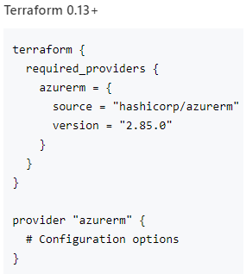
Providers
1. Terraform providers for Azure
- AzureRM provider
- AzureAD provider
- AzureStack provider
2. Authenticate with
- Azure CLI
- Azure Service principal
- Azure Managed Service Identity

Slide 7
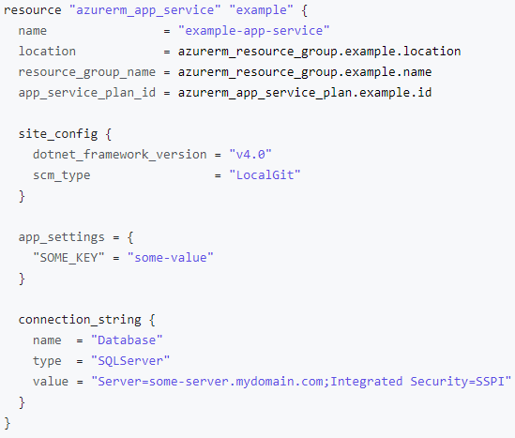
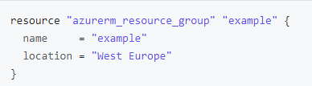
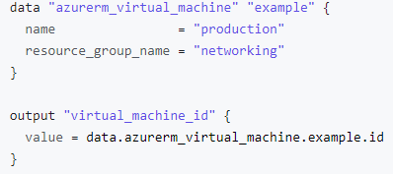
Resource & Data Sources
Resource meta-arguments
- depends_on
- count
- for_each

Slide 8
Modules
1. Modules are libraries/packages that allow you to create multiple resources together.
2. Modules can be loaded from
- local paths
- Terraform registry
- Source code repositories
3. Typical module structure
- Input variables
- Output values
- Resources

Slide 9
CLI

Slide 10
Workflow
Terraform Workflow
init
validate
apply
destroy
plan
1
2
3
4
5
terraform init
terraform validate
terraform plan
terraform apply
terraform destroy

Slide 11
Feature Comparison
Feature | ARM/ AZ CLI /BICEP | Terraform
Infrastructure as Code (IaC) | Yes | Yes
Readability | JSON | HashiCorp Config Language (HCL)
Execution plans | No | Yes
Dependencies | Yes (Explicit) | Yes (Implied)
Multi-Cloud | No | Yes
Rollback State | Yes – deploy prior template / rollback | Yes – maintains state
Corrupted State | State not needed | Can be an issue
Supports Dev Ops | Yes | Yes
Cost / Support | Free, uses Azure support | Free / Paid (purchase support)
Parallel deployments | Yes | Yes
Runs “Locally” | ARM template is uploaded / deployed in Azure | Terraform uses REST calls via a client machine
Sub-Templates/Modules | Yes – Linked Templates | Yes – Modules
Deploy to multiple resource groups | Requires many template | Can be done in one template

